Slide 1





Fake news detector
Springboard CAPSTONE 3 PROJECT – Jonny Pearce – July 2023

Slide 2

The PRoblem
Reliability of information key to businesses government and media around the world
Rise of misinformation and fake news has massive impact on society as well as ability to sell products and services.
Businesses have to cope with product/service reputation issues, along with legal/regulatory issues and legal liability risks.
Thus knowing what is true and fake in terms of protecting your business and enhancing your corporate profile is crucial.
Reliable and effective tools to manage fake news and false/misleading information more and more important

Slide 3

The data
Taken from https://www.kaggle.com/datasets/jruvika/fake-news-detection?select=data.csv
Contains publication URLs, headlines, full content and binary ratings on over 4000 news articles
Standardised and cleaned to:
Remove punctuation.
Remove non-alpha-numeric characters.
Change all the text to lower-case
Consider any other content issues, eg, removing website addresses, etc.
Drop null values

Slide 4
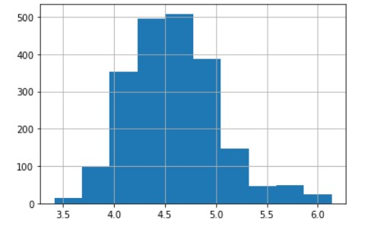
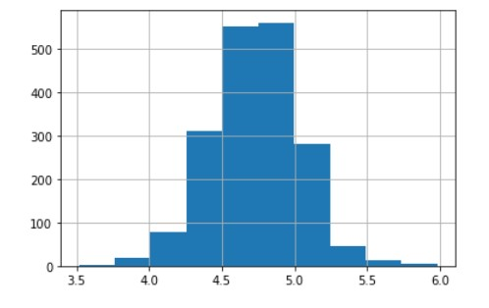
Exploratory analysis (1)
Fake
The average number of characters in fake news stories was 2395 compared to 3620 for the true stories.
The average number of words in fake news stories was 417 compared to 618 for the true stories (and 511 for all the articles in the dataset).
So, as a rule of thumb, the fake news stories were about one-third shorter than the true stories.
Histograms on the average word length show that the fake news articles had a lower average word length than the true stories
True
Average word lengths of article for fake news and true stories subsets

Slide 5
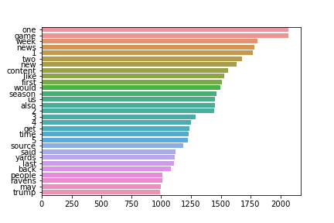
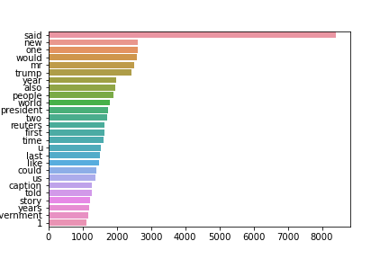
Exploratory analysis (2)
Fake
Removed stopwords
8,000+ uses of “said” in true stories compared to 1,000+ in fake news
Suggests that validation, attribution and accurate citing of sources play a strong role in the true stories
True
Top non-stopwords in fake news and true stories, respectively

Slide 6
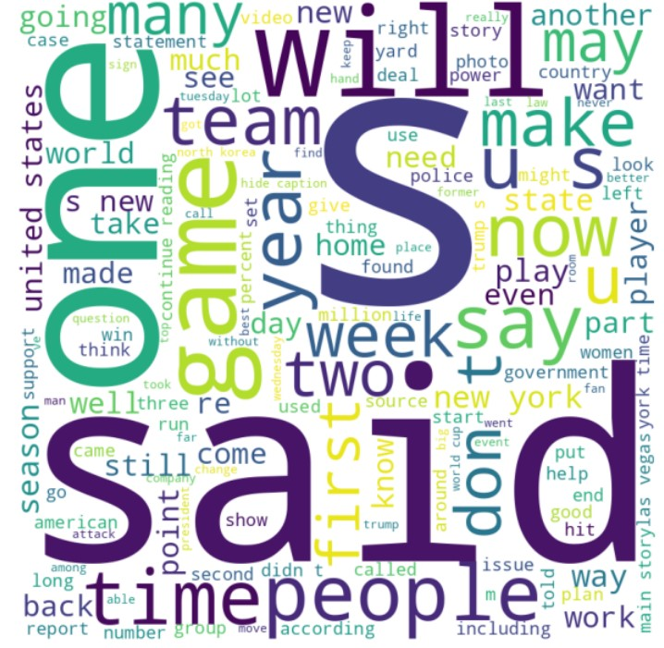
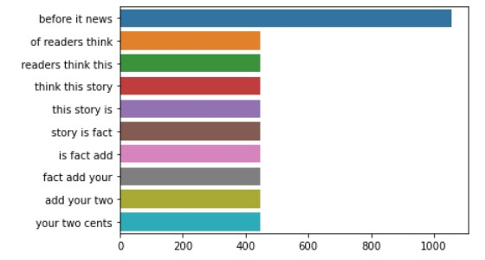
Exploratory analysis (3)
Top trigrams in fake news
Word cloud of full dataset

Slide 7

MODELLING AND SELECTION
Vectorization
Term Frequency – Inverse Document Frequency
Word2Vec – didn’t work very well
Classification
Passive Aggressive Classifier
Random Forest Decision Tree Classifier
Logistic Regression Classifier
Linear Subject Vector Classifier
Naive Bayes Multinomial Classifier

Slide 8

Model selection
However, two stood out:
PassiveAggressive Classifier; and
Linear SVM Classifier.
Not only were accuracy scores slightly higher, but the number of false positives (ie, the number of fakes news stories that they let through) were significantly lower than the other algorithms (6 and 8, respectively, compared to double figures for the others and sometimes into the high 20s).
Initial results
All models had good accuracy results:
Passive Aggressive - 98.37%
Random Forest - 96.49%
Logistic Regression - 97.37%
Linear SVM - 98.5%
Multinomial Naive Bayes - 93.86%

Slide 9
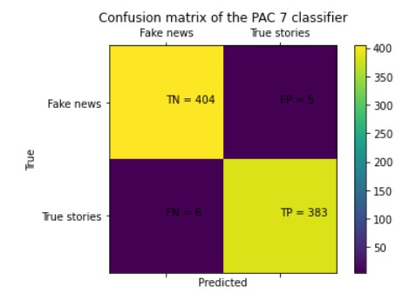
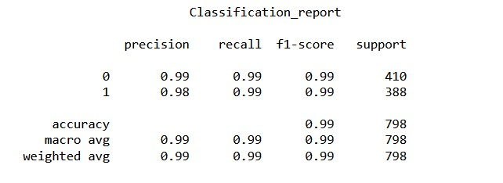
Further testing and refinement
Worked further with PAC and Linear SVM models:
Manual and GridSearch parameter tuning.
No improvement to Linear SVM
Some improvement to PAC model.
Passive Aggressive Classifier final selected model

Slide 10

Conclusions and next steps
Having tried a number of classifiers, it's clear that once you have a cleaned, standardised and vectorized dataset of articles/text, it's possible to build a passable model with many of them.
However, only the PassiveAggressive Classifier and the Linear Subject Vector Machine Classifier were really up to the job.
Parameter tuning offered only marginal improvements, but worth doing for the PassiveAggressive Classifier.
In terms of word vectorization, interesting to see that TF-IFD performed well, in marked contrast to Word2Vec. May be that Word2Vec works better on much larger datasets.
Next steps:
Deploy model
Refine with larger datasets
Test with different categories of content

Slide 11
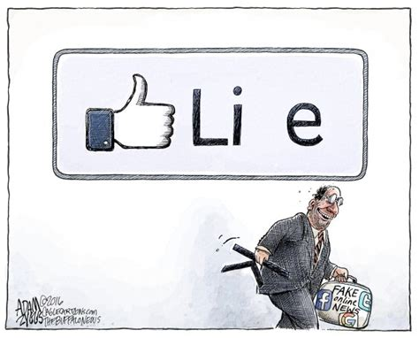
Questions?

